Slide 1


Slide 2
What is CloudHour?
Objective of CloudHour
Round-table discussion
Focus on a few key topics
Why It's Important
Rapid changes in cloud security and tech
Stay updated and connected for growth as community
How it will benefit the community
Real-time engagement with hosts and community members
Ask open questions and speak your opinion
Opportunity to affect the next agenda
Notes:
Objective of CloudHour
The objective of CloudHour is to create a collaborative space where professionals can come together to discuss, learn, and share insights on the most pressing topics in cloud security and modern workplace technology.
Why its important
CloudHour is important because, in the rapidly evolving landscape of cloud security and workplace technologies, staying updated and connected is crucial for career growth and organizational resilience
How it will benefit the community
By attending CloudHour, community members will have the unique opportunity to engage with industry experts in real-time, ask questions, network with like-minded professionals, and even have the chance to contribute their own expertise by becoming guest speakers in future episodes.

Slide 3

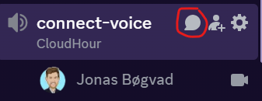
If you prefer to not talk or be asked questions press mute
press mute just mute the mic
If you preferer to chat press

Slide 4
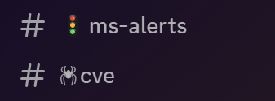
State of the server
New channel’s (thank you Devfender)
Cve (from MSRC Security)
Ms-alerts (from ServiceHealth)
Be polite and at least say thank u and a follow up if you got help or feedback by anyone.

Slide 5
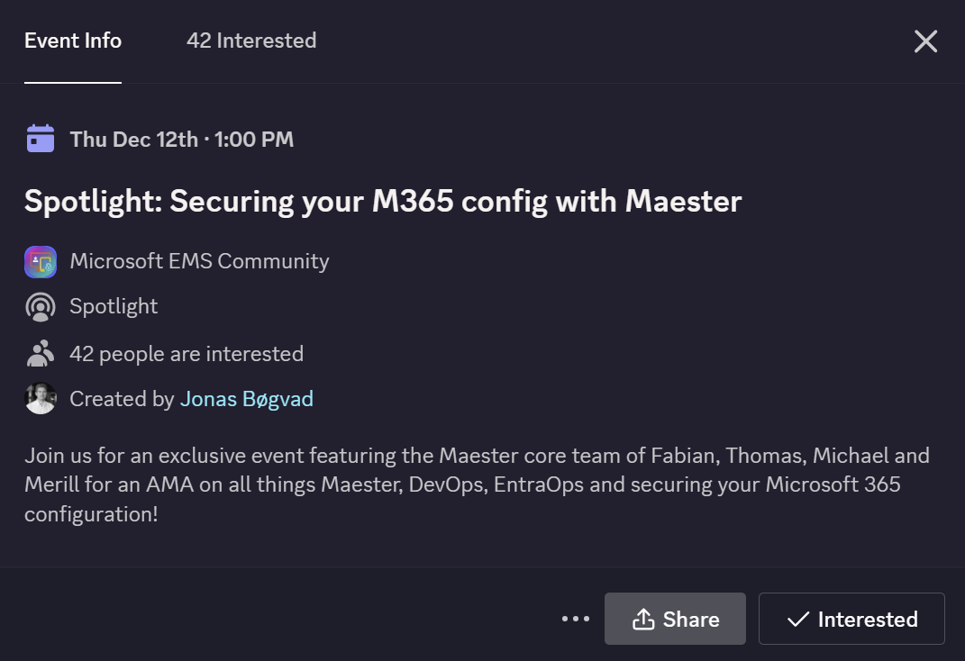
Spotlights sessions
Maester Core come and talk about Measter in december (Confirmed💪)
Upcoming Spotlight sessions
Token Theft
MS Security Service Edge solution
OSD Cloud​
IntuneCD​
Rudy Webinar (From Lewis)​
Johan Arwidmark (From Matt)​
Purav (from Dev)​
Kelvin from CIPP (From Lewis)​
Andrew Taylor (from Dev)​
TUGI tool (from Joel)​
WinTuner Stephan van Rooji (from Dev)

Slide 6
Maybe for you (feel free to add)
Tech community blog upgrade (no link)
Microsoft Zero Trust Workshop
Windows 11 Security Book
Verified ID Webinar by MS
NIS2 Readiness: A Guide for Organizations in Europe
Universal Continuous Access Evaluation (on next slide)
Ignite Top 10 takeways (on next slide)
Notes:
https://microsoft.github.io/zerotrustassessment/
https://learn.microsoft.com/en-us/windows/security/book/
https://techcommunity.microsoft.com/blog/identity/join-the-verified-id-webinar-series/4175878
https://www.microsoft.com/cms/api/am/binary/RW1nRyk?wt.mc_id=AID3072123_QSG_PD_SCL_657967&ocid=AIDN%2FA_LINKEDIN_oo_spl100006578110177

Slide 7
Universal Continuous Access Evaluation (preview)
Tool to add into the Token theft prevention scenario.
Preq
Conditional Access understanding
Network fundamentals
Tokens fundamentals (to understand the benefit)
Tool to prevent token theft
Global Secure Access detects user identity changes in near real time and prompts reauthentication via a claims challenge, even with a valid access token.
Video by John Savil (https://www.youtube.com/watch?v=m3309aUKET8)
Notes:
https://learn.microsoft.com/en-us/entra/global-secure-access/concept-universal-continuous-access-evaluation
https://www.youtube.com/watch?v=m3309aUKET8

Slide 8
How did you feel about Ignite?
AI AI / Copilot
Few Sessions

Slide 9
Agenda
Microsoft Ignite takeaways! (you already forgot?) 👈
Cloud PKI
MCAS / MDA / Defender for Cloud
Global Secure Access / Microsoft’s Security Service Edge (SSE)
Administrative templates to Settings Catalog
Questions for Maester visit, next week.

Slide 10
Ignite 2025 - Top 10 takeaways
Cloud Native still top of mind by MS
Copilot for Intune and Copilot for Security
Entra Private Access
Hotpatch, no restart needed for Security patches
Windows 365 Link, new small device
SharePoint Copilot Agents
Entra Private Access Agent (Support for macOS and IOS)
Security Exposure Management
Intune – Smart App Control og App Control for Business
local administrator protection (matt)
Quick Machine Recovery (Voltharion)

Slide 11
Agenda
Microsoft Ignite takeaways! (you already forgot?)
Cloud PKI 👈
MCAS / MDA / Defender for Cloud
Global Secure Access / Microsoft’s Security Service Edge (SSE)
Administrative templates to Settings Catalog
Questions for Maester visit, next week.

Slide 12
Cloud PKI
text

Slide 13
Agenda
Microsoft Ignite takeaways! (you already forgot?)
Cloud PKI
MCAS / MDA / Defender for Cloud 👈
Global Secure Access / Microsoft’s Security Service Edge (SSE)
Administrative templates to Settings Catalog
Questions for Maester visit, next week.

Slide 14
MCAS / MDA / Defender for Cloud
text

Slide 15
Agenda
Microsoft Ignite takeaways! (you already forgot?)
Cloud PKI
MCAS / MDA / Defender for Cloud
Global Secure Access / Microsoft’s Security Service Edge (SSE) 👈
Administrative templates to Settings Catalog
Questions for Maester visit, next week.

Slide 16
Global Secure Access / Microsoft’s Security Service Edge (SSE)
text

Slide 17
Agenda
Microsoft Ignite takeaways! (you already forgot?)
Cloud PKI
MCAS / MDA / Defender for Cloud
Global Secure Access / Microsoft’s Security Service Edge (SSE)
Administrative templates to Settings Catalog 👈
Questions for Maester visit, next week.

Slide 18
Administrative templates to Settings Catalog
text

Slide 19
Agenda
Microsoft Ignite takeaways! (you already forgot?)
Cloud PKI
MCAS / MDA / Defender for Cloud
Global Secure Access / Microsoft’s Security Service Edge (SSE)
Administrative templates to Settings Catalog
Questions for Maester visit, next week. 👈

Slide 20
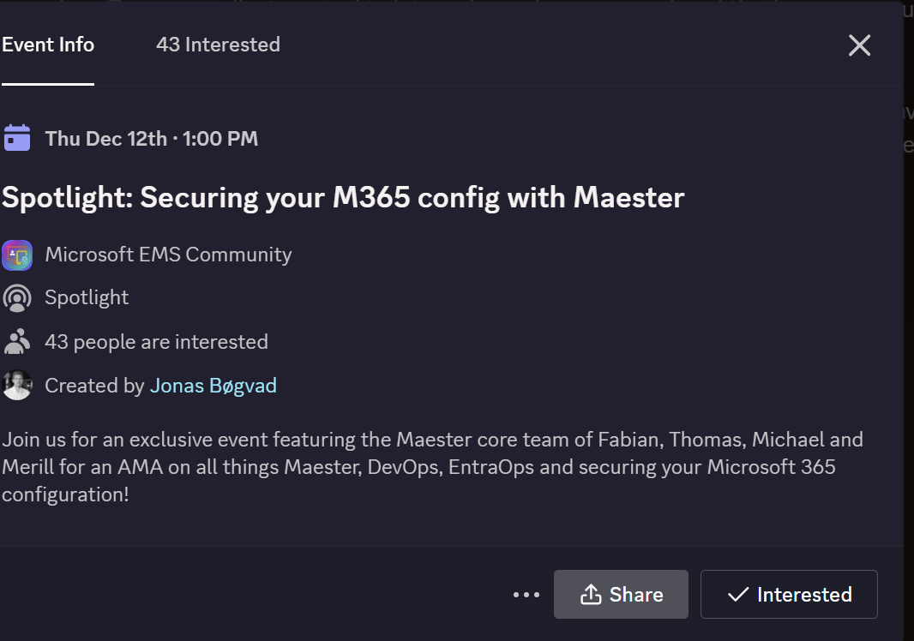
Questions for Maester visit, next week.
Opportunity to show MS that we are serious

